Slide 1
226 Java SL DP - RLL - Group 2
“EMPLOYEE PAYROLL MANAGEMENT”

Slide 2
Presented by:
Chennupalli Sujith Vardhan Reddy(Team Lead & FrontEnd Lead) 2525907
Chinthagunta Vamsi Krishna Reddy(BackEnd Lead) 2525909
Bukke Sai Kumar Naik 2528237
Bhairu Lal Jat 2525870
Bhargav N 2525452
Bhukya Vamshi 2525897
C Arockya Jainisha 2528504
Bhuvaneshwaran Ramasamy 2530171
Chandangowda T P 2527975
Dhayananth X 2526798

Slide 3
Contents:
Introduction
Objectives
Tools and Technologies
Flow of Application
Data Flow
E-R Diagram
Features of EPM
Output Screenshots
Future Scope and Improvements

Slide 4
Introduction:
Employee payroll management system is an Internet-based Java application that automates the working of a company or work center that manage and maintain records of the employees in the different department.
The proposed project “Employee Payroll Management System” has been developed to overcome the problems faced in the practicing of manual system
This web application is reduced as much as possible to avoid errors while entering data. It also provides error message while entering invalid data.

Slide 5
Objective:
The objective of the Employee payroll management system project is to design a scheduling system for a work center.
The supervisor holds the various activities maintain salary details ,mark attendance, and deleting the employees, and on the other hand employees view their details, view schedule and view attendance.

Slide 6
Tools & Languages:
Front End
Visual Studio
Angular
HTML
CSS
BOOTSTRAP
Back End
Eclipse
Spring Boot
MySQL
Hibernate
Postman

Slide 7
Admin
Flow Of Application:
Login
user
Home Page
Admin Actions(add/delete/view)
User Actions
Employee
view Attendance
Salary
Salary
Attendance
view Leaves
Schedule
Schedule
Log out

Slide 8
Attendance
Data Flow:
User
Leaves
Employee payroll Management System
Employee
Data Base
Salary
Admin
Schedule

Slide 9
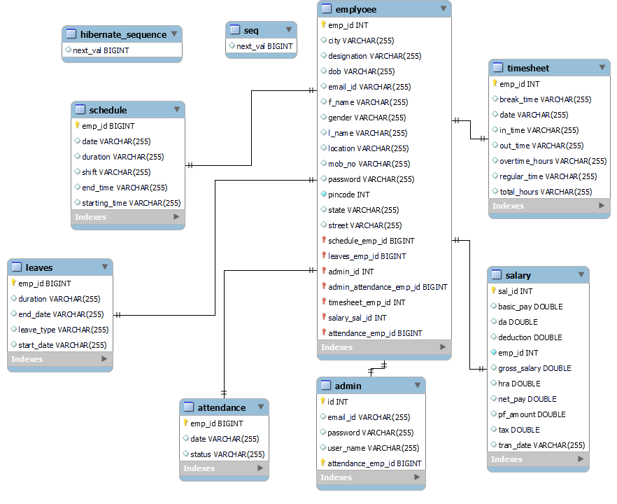
Entity Relationship Diagram:

Slide 10
Features of EMP:
Easy to use. ​It is completely secure.
​This system is easily compatible with most of the web browsers.
​Admin can view all the records whenever necessary with ease and can add/delete various components like salary , attendance, scheduling work.
Store the end-end data of employees & Admins.

Slide 11
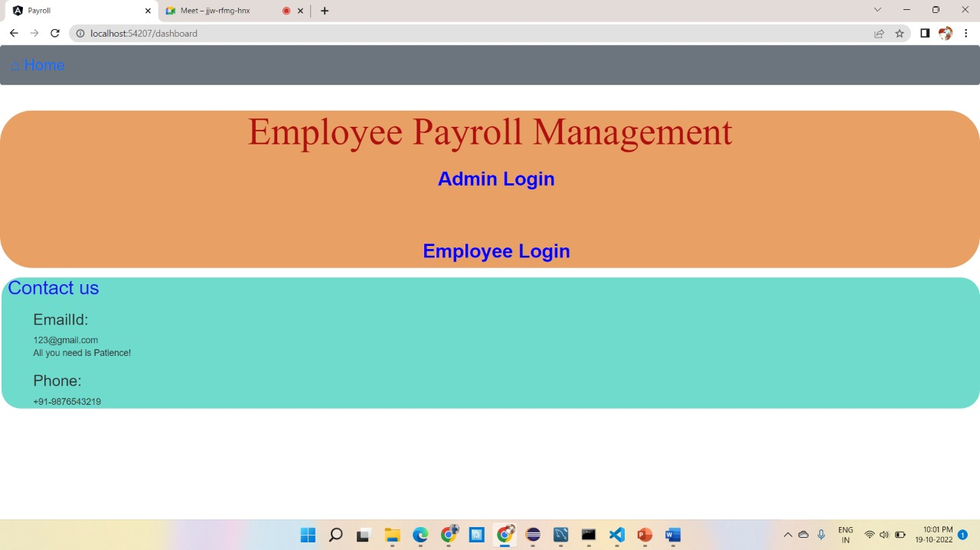
Output Screenshots:
Home Page:

Slide 12
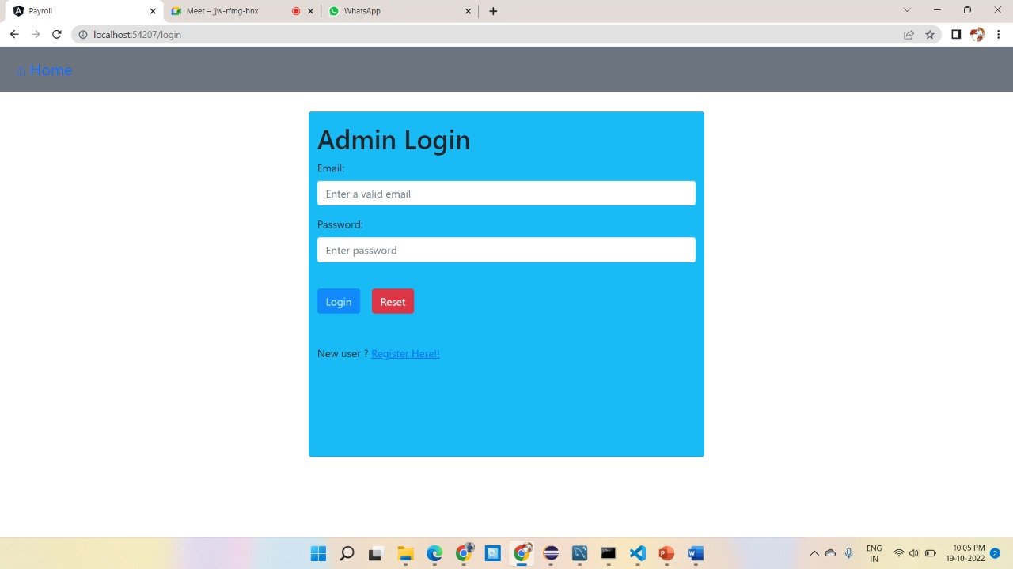
Admin login:

Slide 13
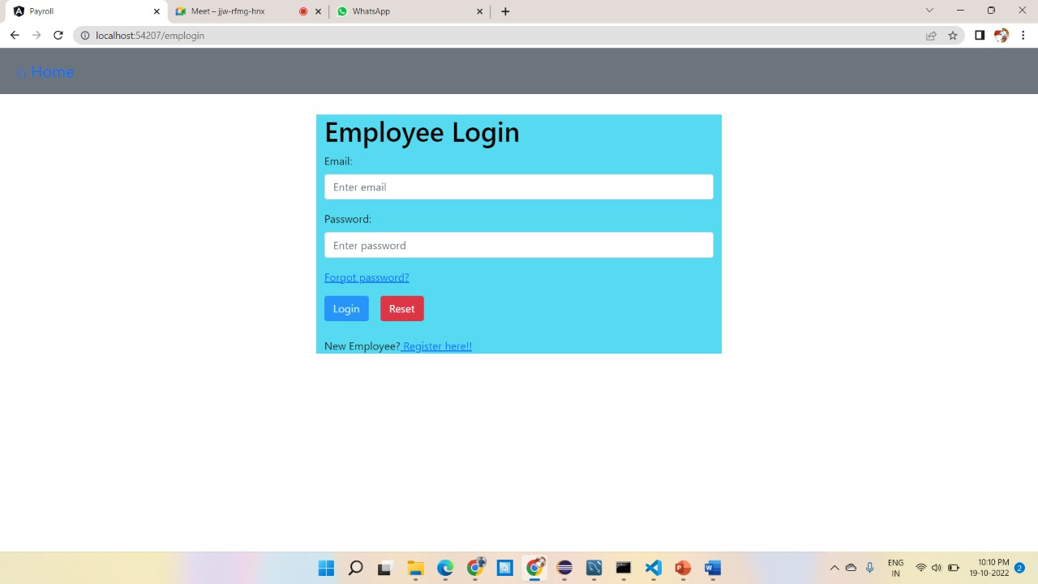
Employee Login:

Slide 14
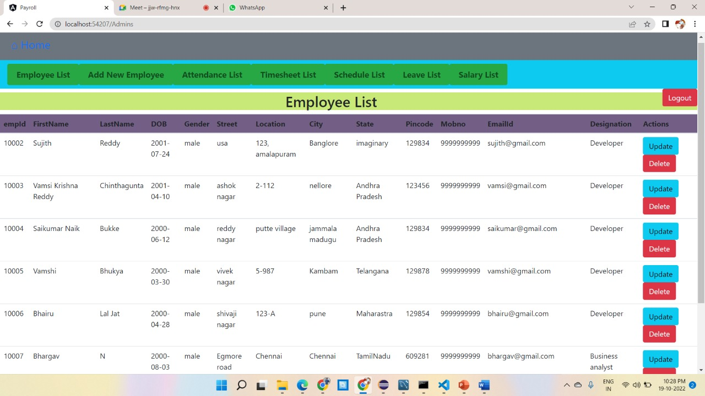
Employee List:

Slide 15
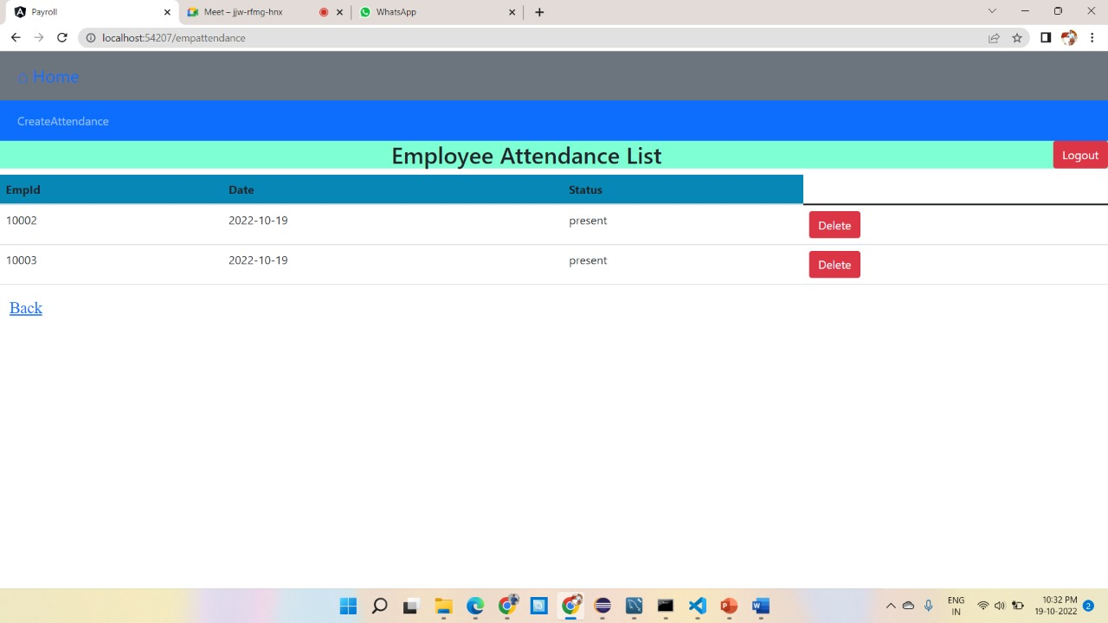
Employee Attendance List:

Slide 16
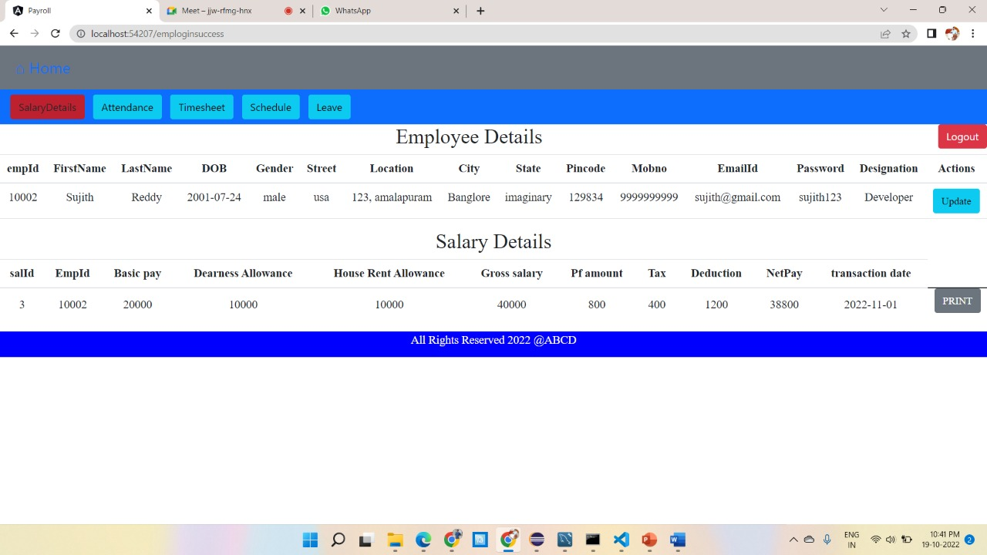
Employee Details & Payslip:

Slide 17
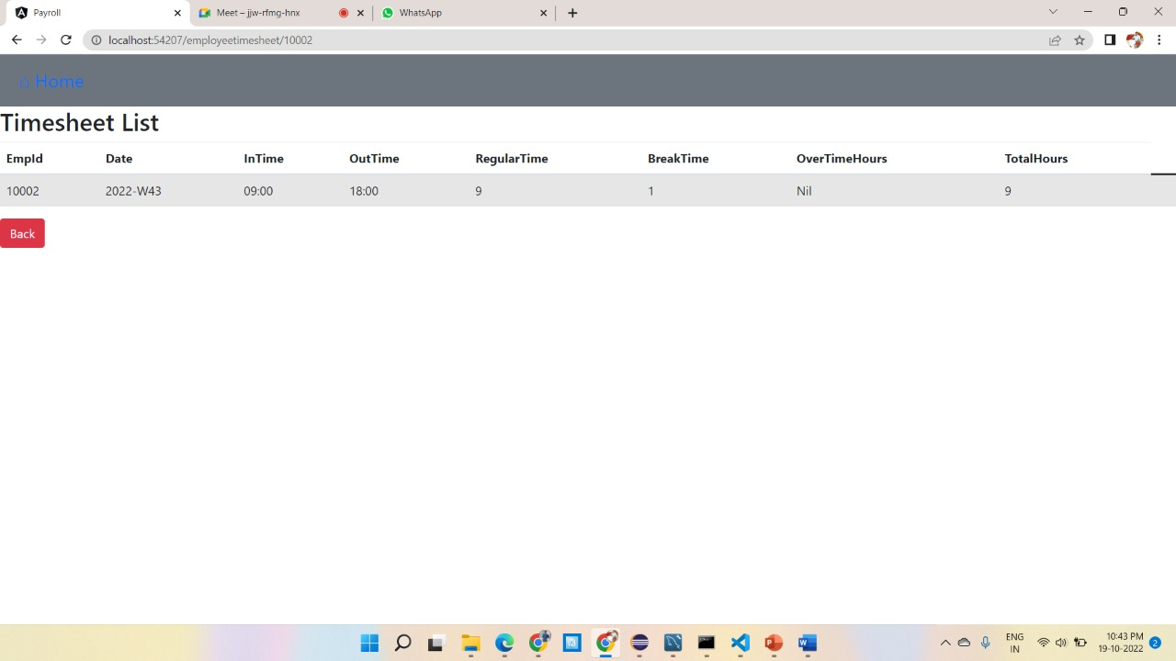
Employee Timesheet:

Slide 18
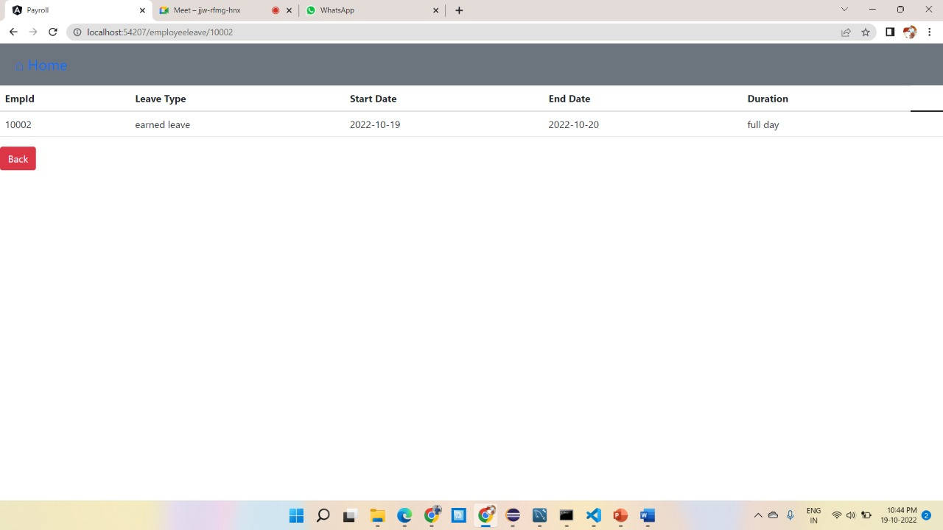
Leave List:

Slide 19
Future Scope & Improvements:
This application can be accessed simultaneously by users from different divisions when they are seated at various locations because it is installed on numerous PCs that share the same database. ​
To manage all departments that will be spread out across several locations, we can create an application in the future that will host the database and have an online application domain.

Slide 20
Conclusion:
This project was created with the idea that both administrators and employees would use it. It is designed to be used in smaller organizations with fewer people.
The administrator can add, modify, update, and delete all employee data in his organisation in accordance with the requested specification.
The admin has the power to both add and remove employees. For the employees, the admin can also specify specified pay grades.
The administrator can quickly and simply see the necessary records whenever he wishes. The employee gets reimbursed on a monthly basis.

Slide 21
DEMO

Slide 22
THANK-YOU

